Slide 1



Slide 2
„
The word cryptocurrency itself is daunting[...]
“

Slide 3

Foundation

Slide 4
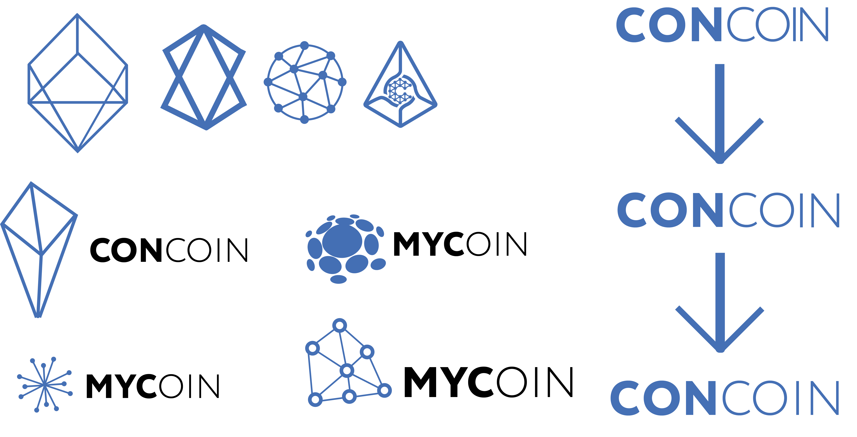
1
2

Slide 5

Connection
Memorable
Abbreviations

Slide 6


Slide 7
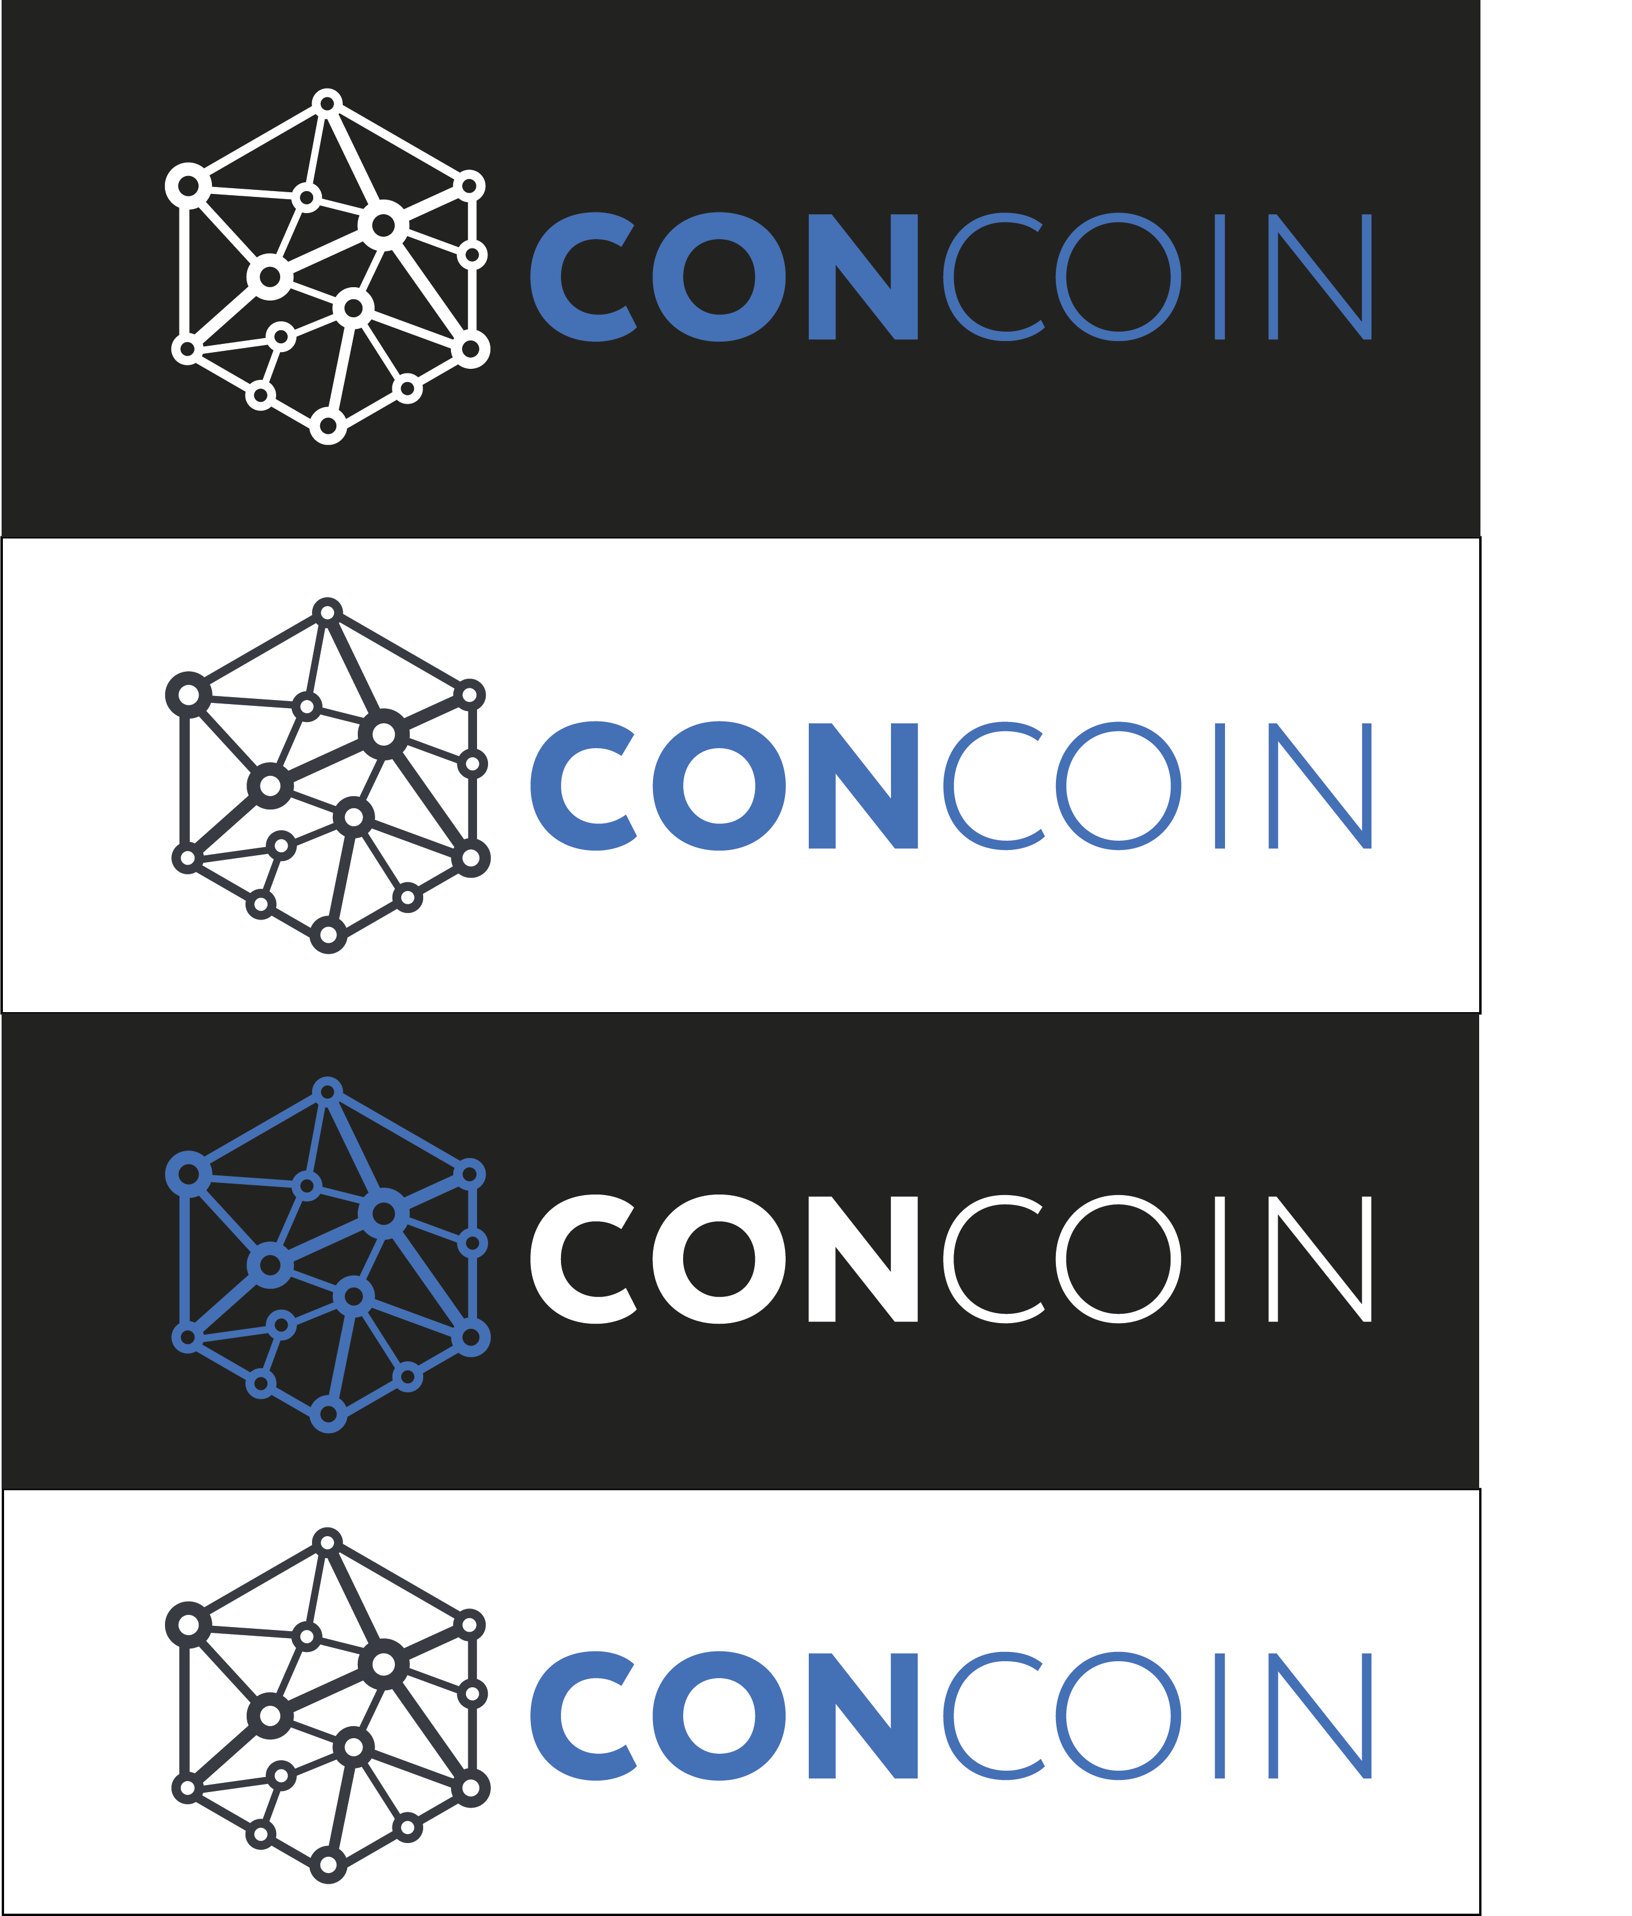


Slide 8

[ The future of payment ]

Slide 11


Slide 12
Print Product

Slide 13
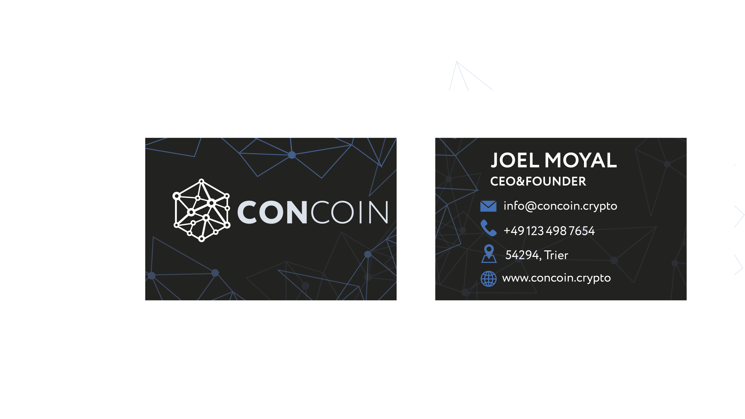

Slide 14
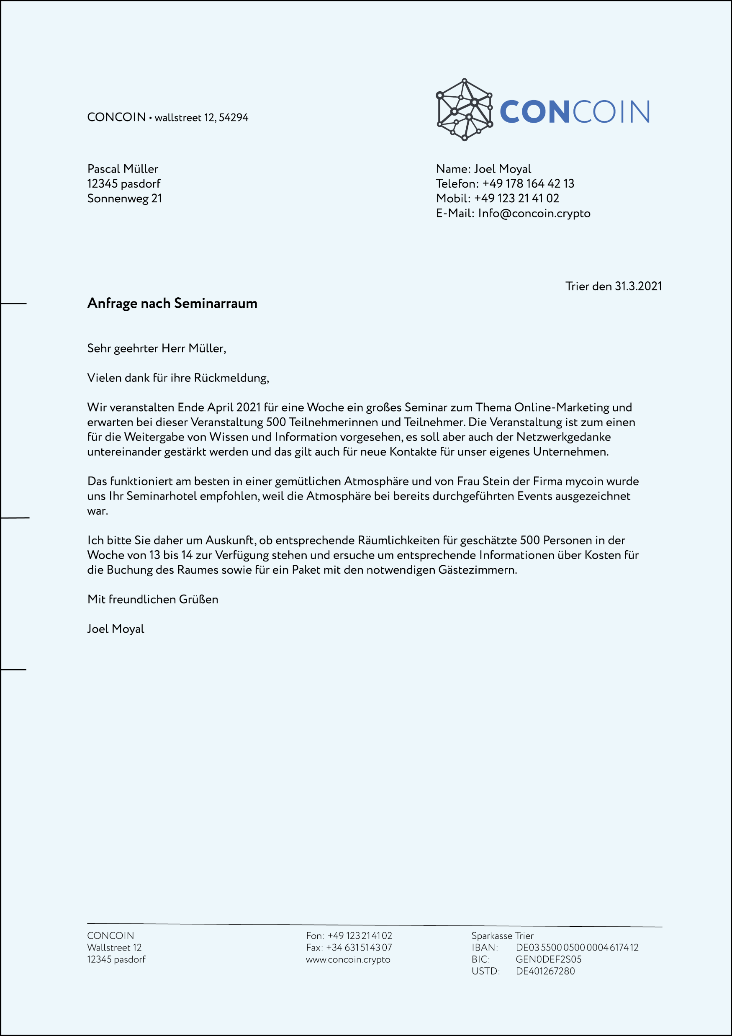

Slide 15


Slide 16
Website

Slide 18


Responsive
Adaptive Design
Mobile First
Slider

Slide 19
CONcoin
BUSINESS

Slide 20

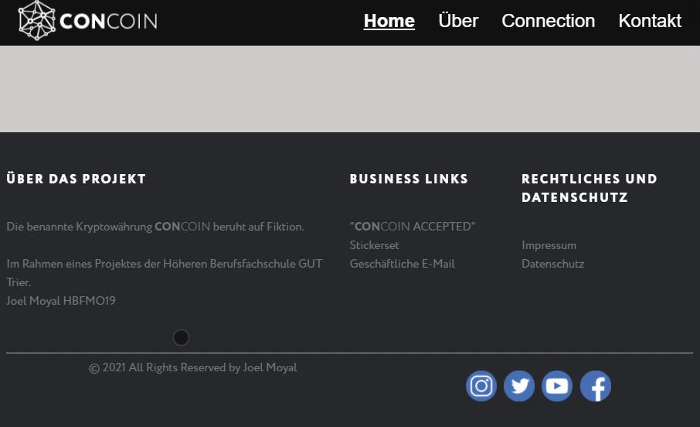

Slide 21
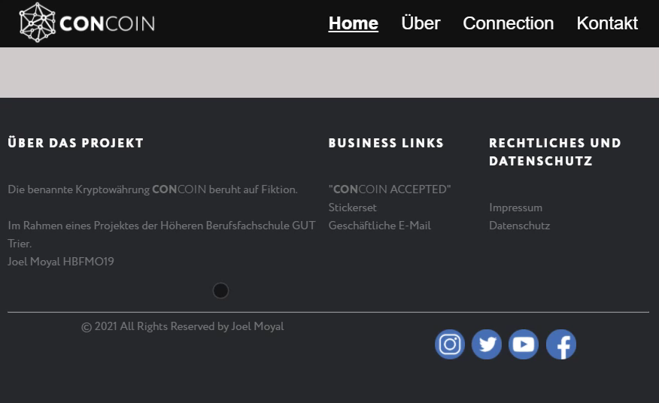

Slide 22
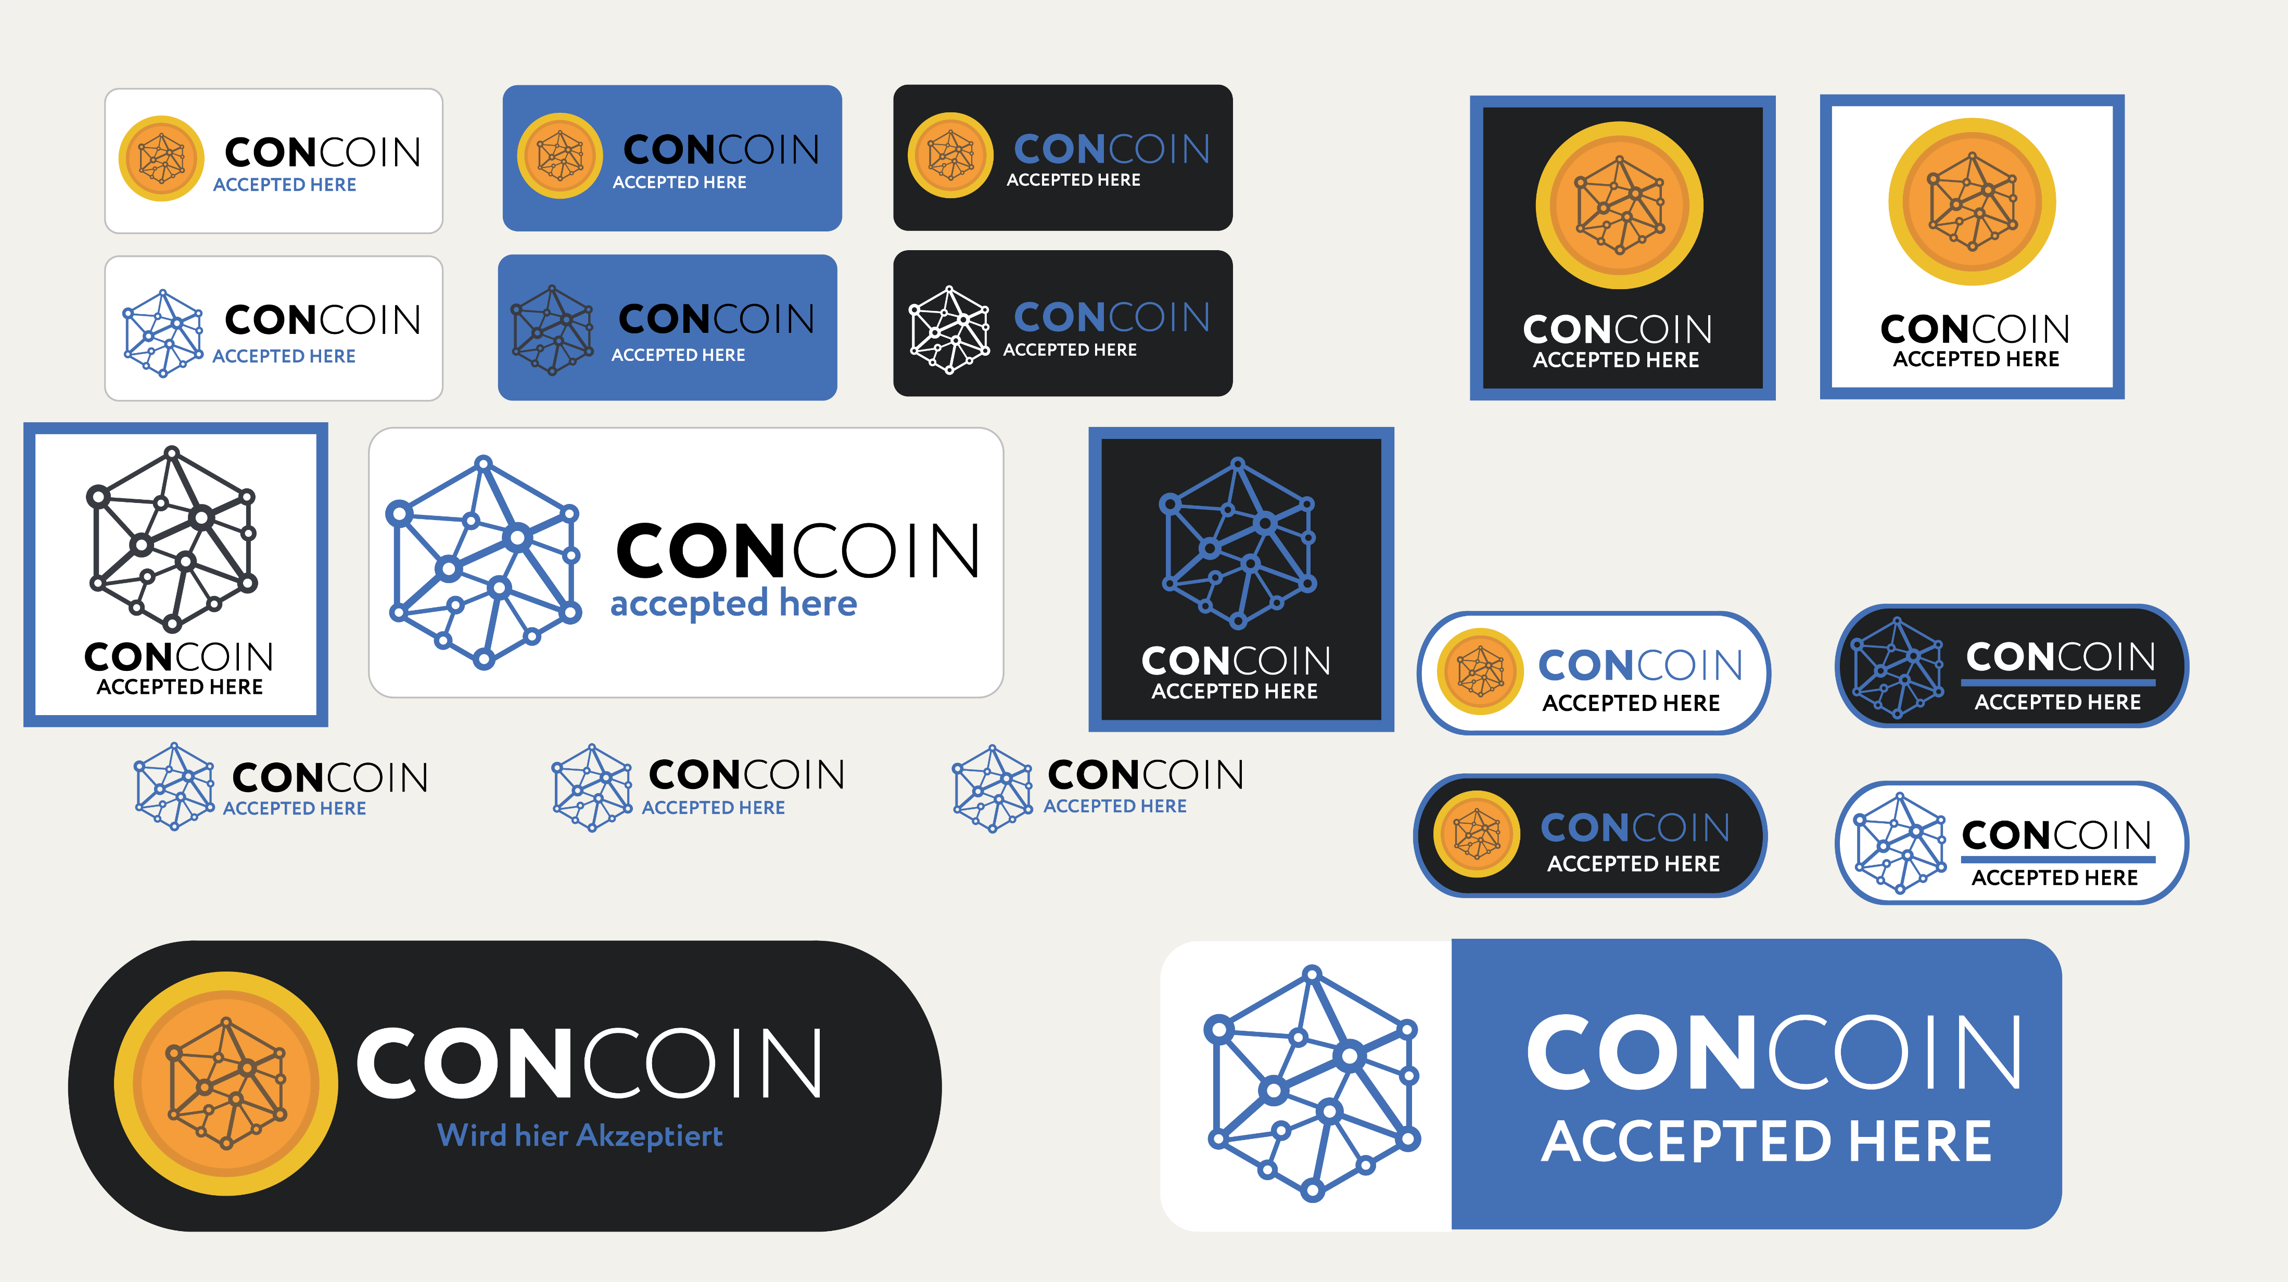

Slide 23
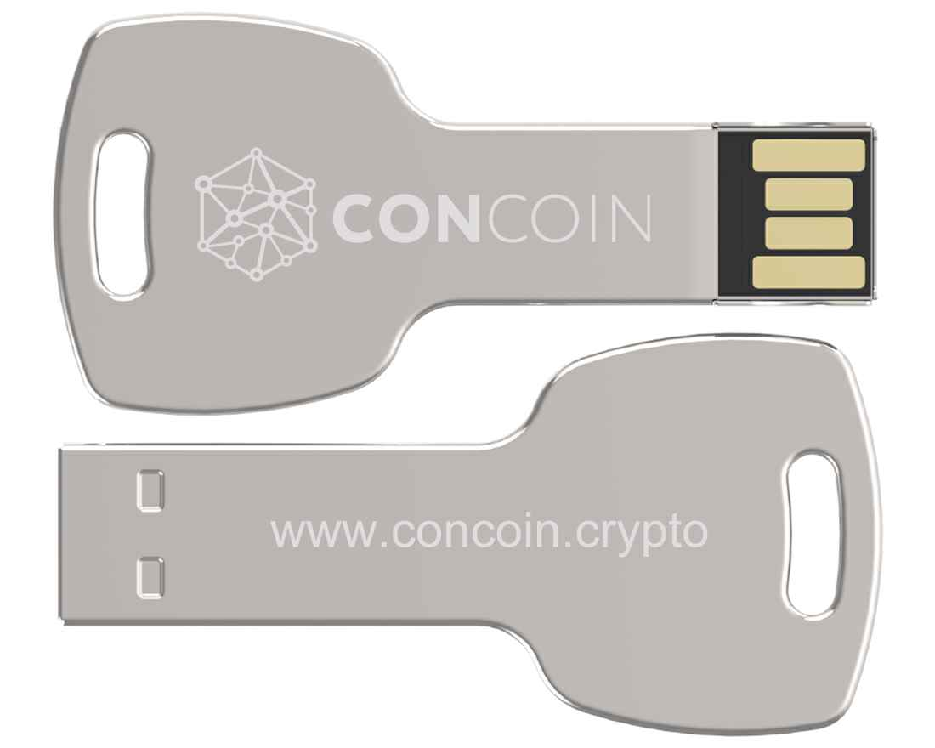
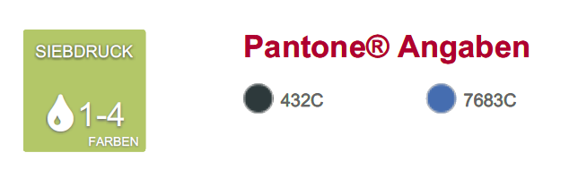
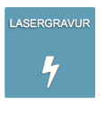

Slide 24
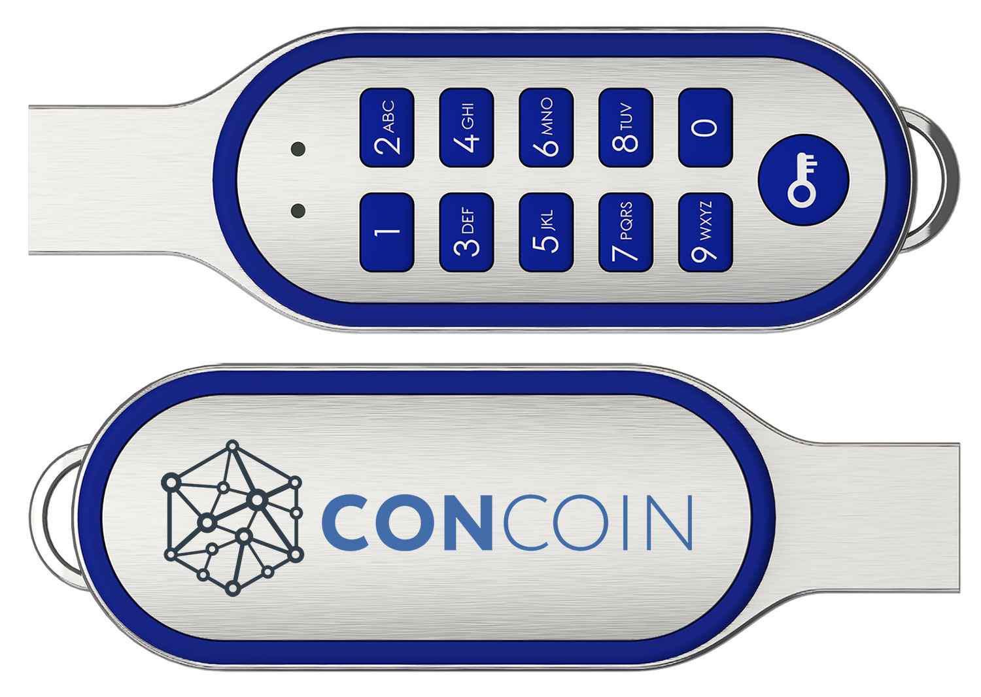
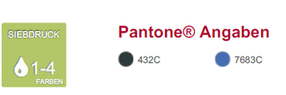

Slide 25
Social Media

Slide 26


Slide 27


Slide 28
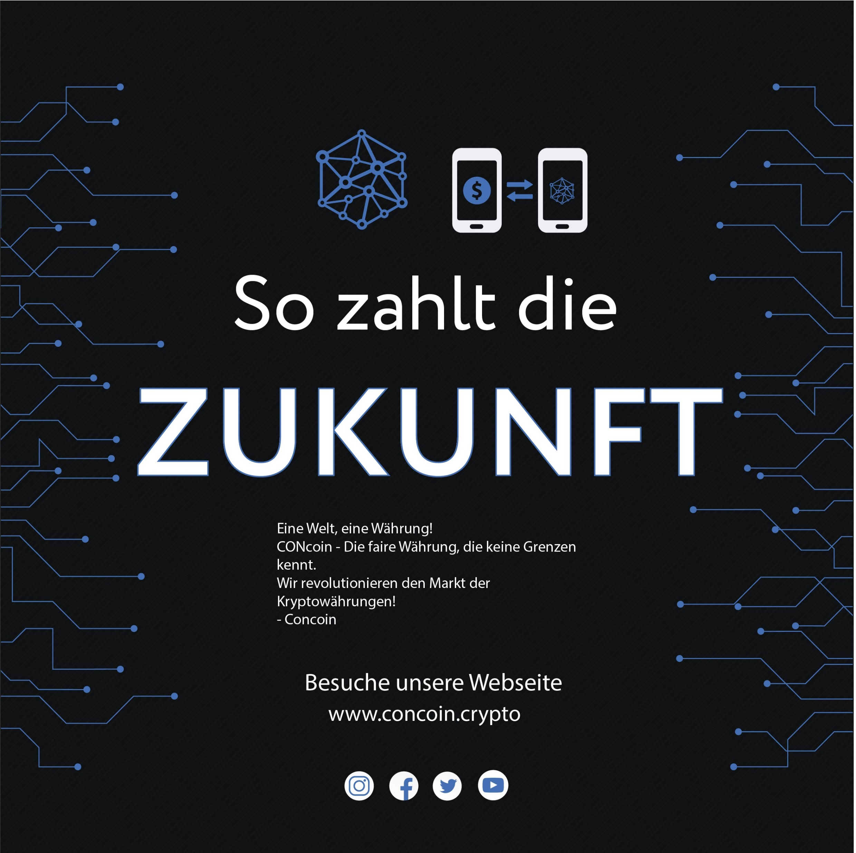

Slide 29
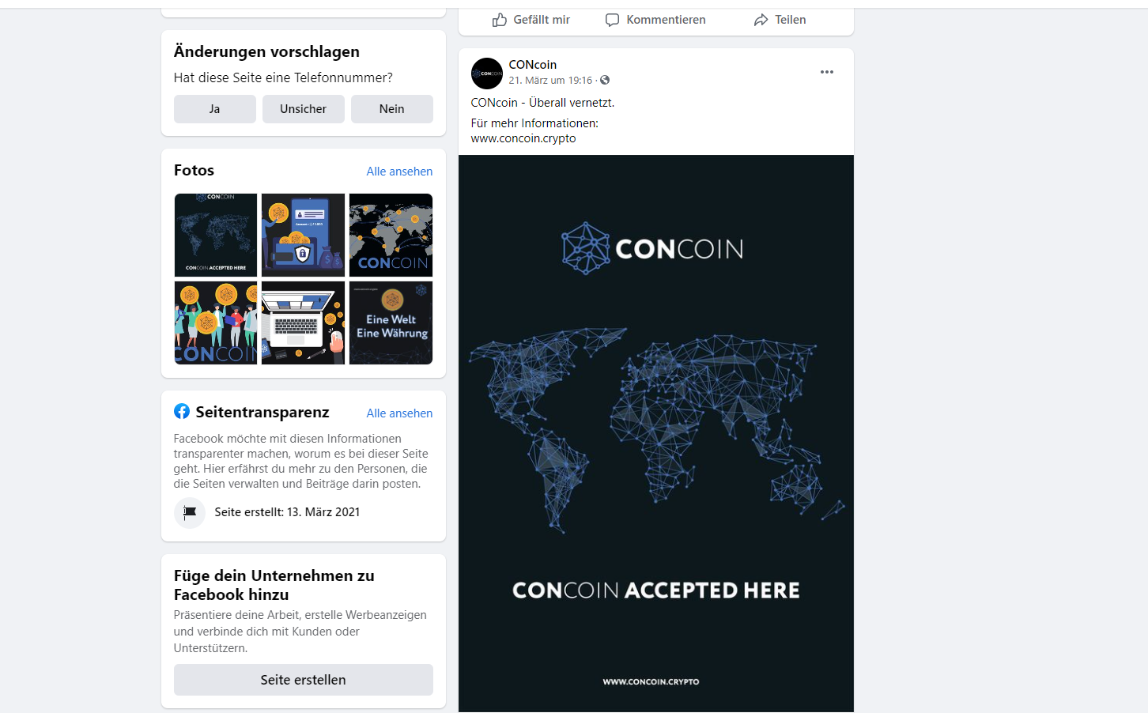

Slide 30
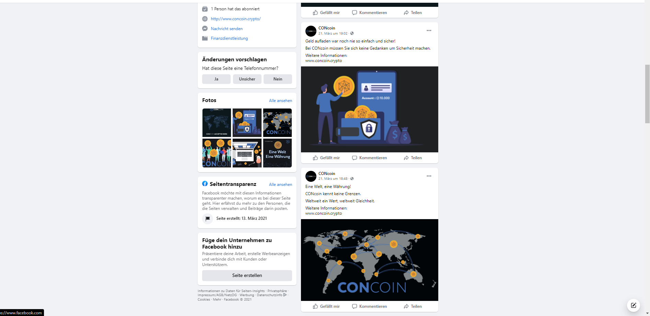

Slide 31
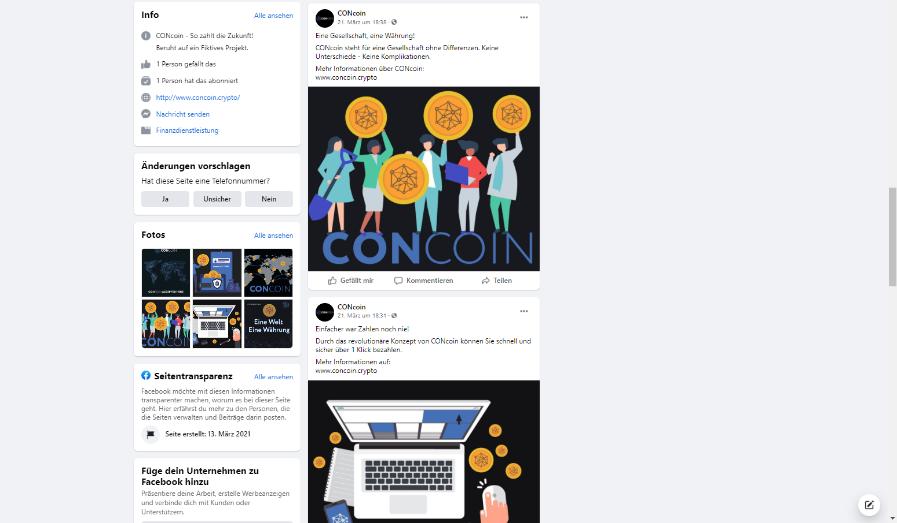

Slide 32
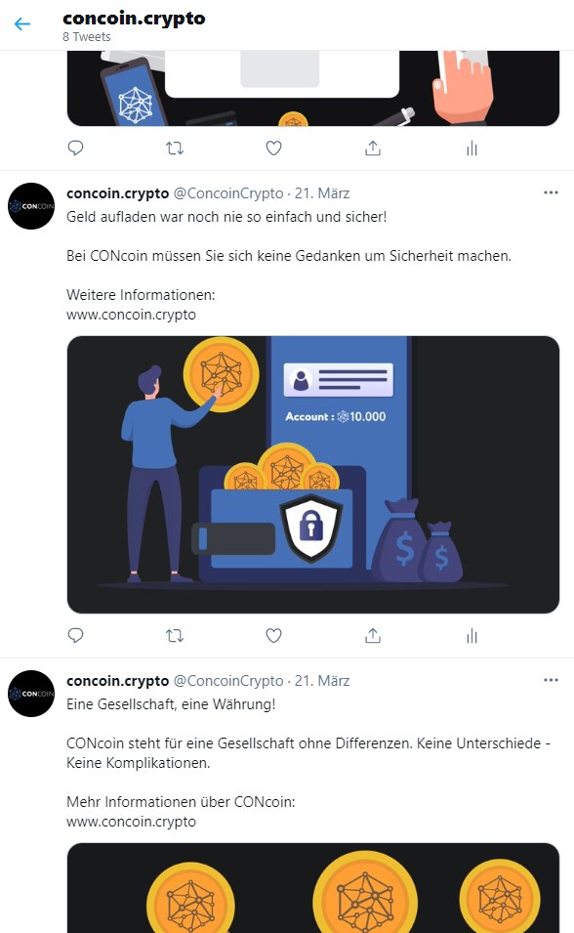

Slide 33
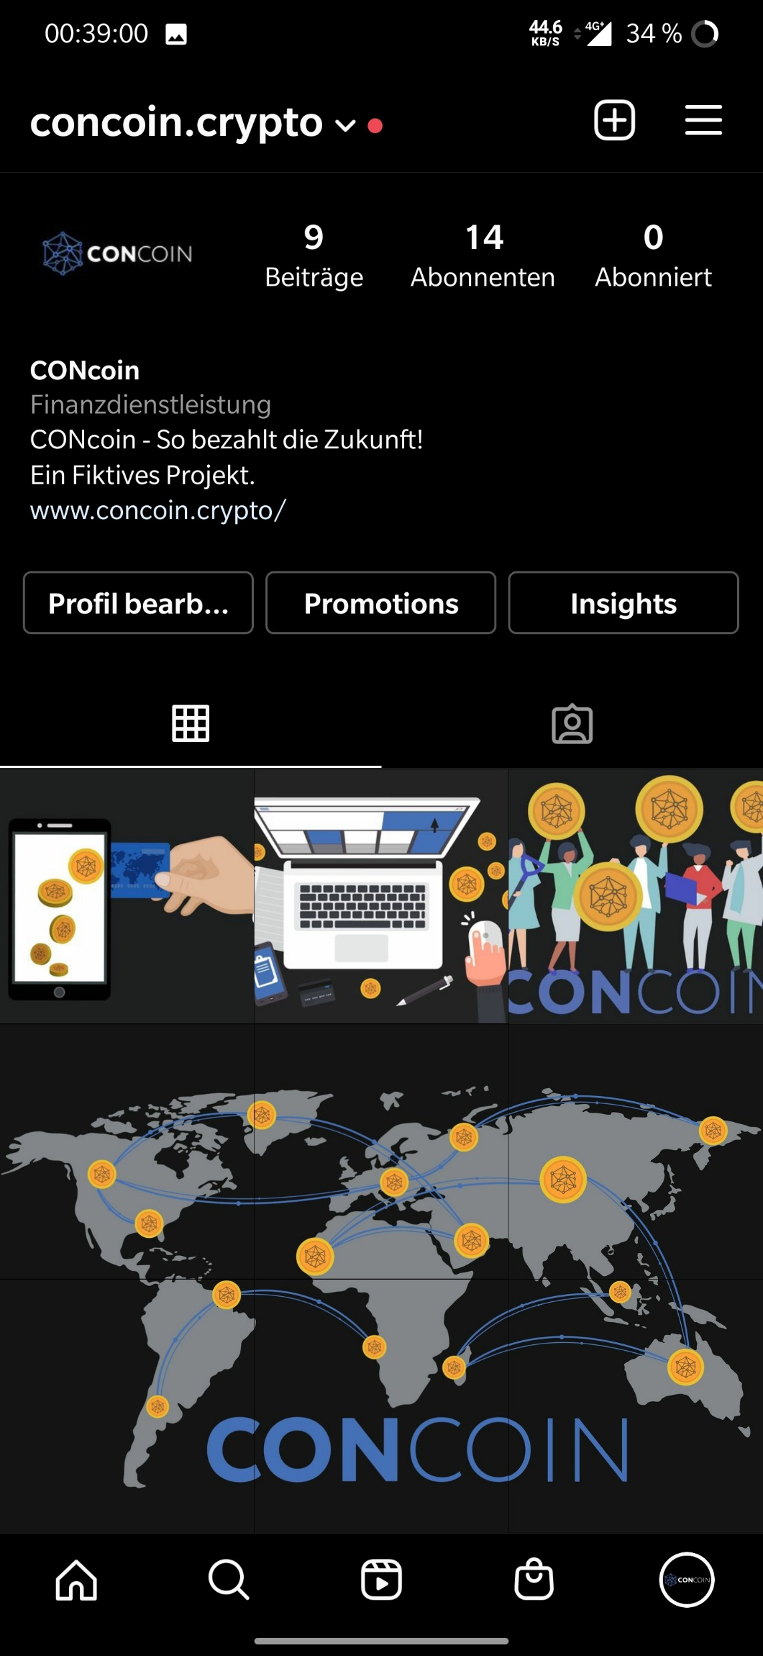

Slide 34
Implementation

Slide 35
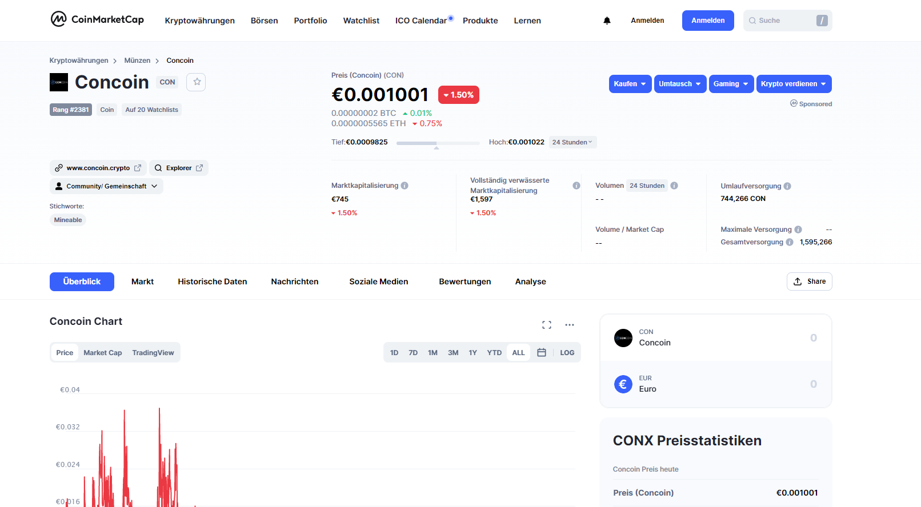

Slide 36
Joel Moyal
BBS GUT TRIER
"Concept and design of a website with selected print products: Logo, Din A2 poster, business card and business stationery for a fictitious cryptocurrency"

